Slide 1

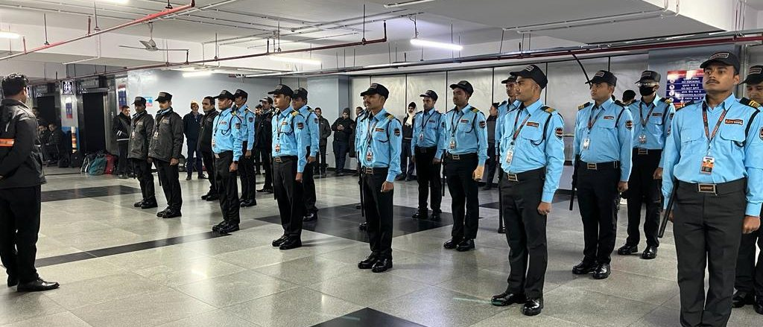

ADS MULTISERVICES
COMPANY PROFILE — SECURITY VERTICAL
SECURITY
SOLUTIONS
Verified people, structured training and 24×7 technology-backed operations — professional on day one, accountable every day after.
ADSMULTISERVICES.IN +91 93110 07739

Slide 2
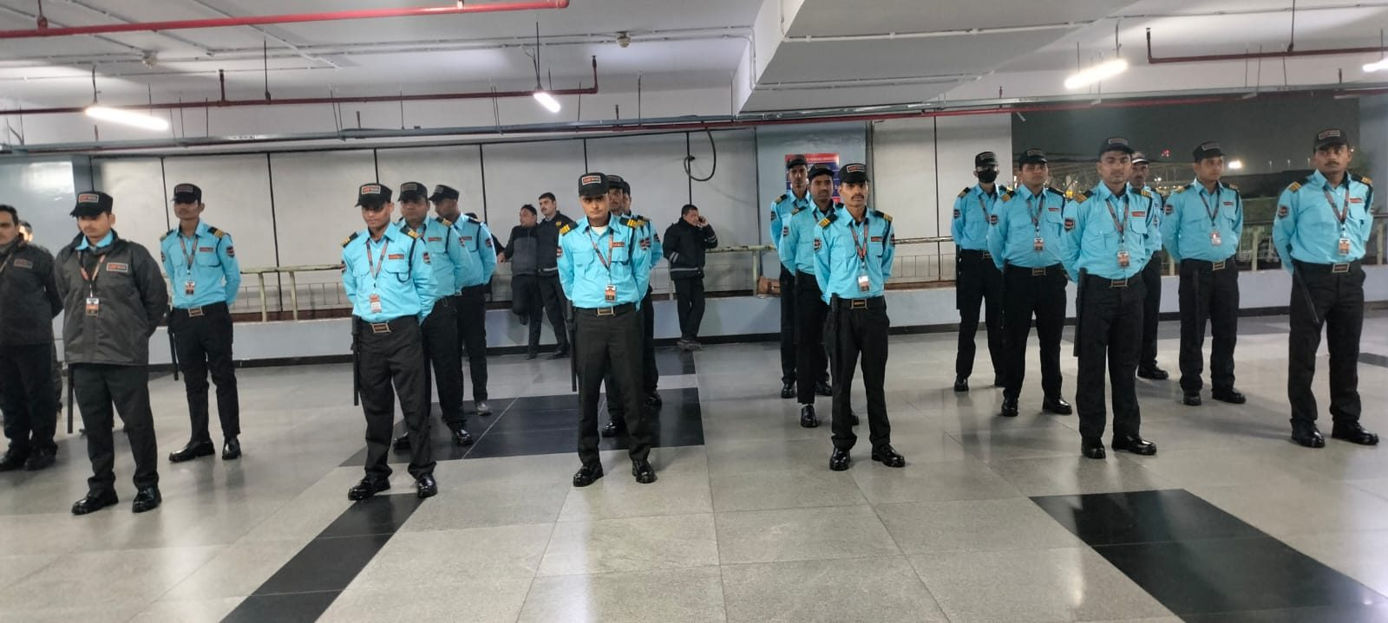
ADS MULTISERVICES
OUR STORY
WHO WE ARE
IMPRESSION ADS MULTI SERVICES PVT. LTD.
Founded in 2022 by Deepak — together with Sunil and Aditya — with one clear mission: reliable, professional, technology-driven business support services under one roof.
Our journey began with security services. Today we are a complete business solutions company delivering Security, Manpower, Transport and Hotel solutions to leading organizations across India.
We don’t just provide services — we build long-term partnerships.
2022
4
ISO
24×7
FOUNDED
SERVICE VERTICALS
CERTIFIED QUALITY
COMMAND CENTER
SECURITY · MANPOWER · TRANSPORT (ADS CABS) · HOSPITALITY (ADS RESIDENCY)
ADS MULTISERVICES · SECURITY SOLUTIONS
02

Slide 3
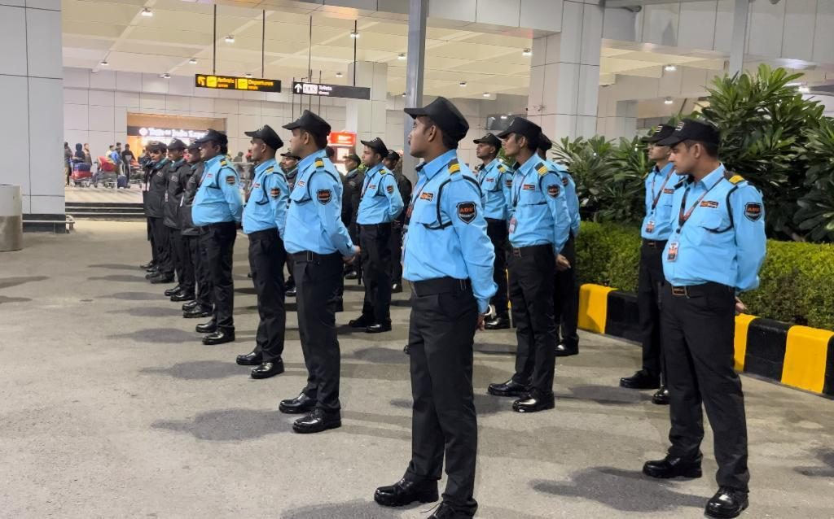



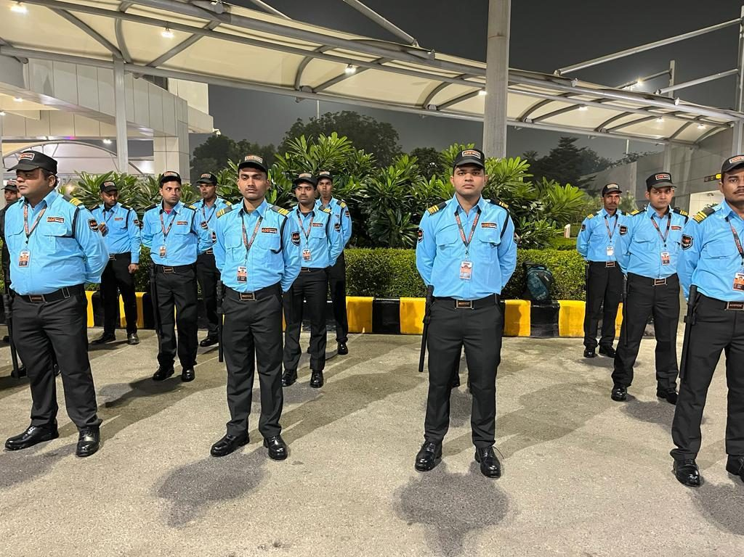

ADS MULTISERVICES
WHAT WE DELIVER
OUR SECURITY OFFERING
STATIC GUARDING & SUPERVISION
Trained, verified security officers with on-site supervisors — banking, aviation, corporate, retail and residential sites.
QUICK RESPONSE TEAMS
Two-tier QRT fleet — bikes first on scene, vans with the full team, equipment and backup.
24×7 COMMAND CENTER
Central monitoring, shift allocation and live field operations tracking across every site.
AIRPORT DEPLOYMENT
COMPLIANT WORKFORCE
Background-checked, medically fit, quarterly-trained professionals — PF, ESI and statutory compliant.
NIGHT OPERATIONS
ADS MULTISERVICES · SECURITY SOLUTIONS
03

Slide 4




ADS MULTISERVICES
SELECTION
WE DON’T HIRE. WE SELECT.
Trusted professionals sourced through referral networks — and screened through four gates before they ever reach a client site.
01
02
03
04
SKILL
EXPERIENCE
CONDUCT
FITNESS
Site and role competence, validated hands-on.
Proven service record with past employers.
Discipline, integrity and client etiquette.
Physical readiness and medical clearance.
Candidates who do not clear a gate do not move forward.
ADS MULTISERVICES · SECURITY SOLUTIONS
04

Slide 5






ADS MULTISERVICES
VERIFICATION & COMPLIANCE
VERIFIED. BACKGROUND-CHECKED.
AADHAAR
PAN
BANK & ADDRESS
Government portal verification
Government portal verification
Account and address proof verified
VERIFIED
VERIFIED
VERIFIED
PAST EMPLOYMENT
BACKGROUND CHECK
FAMILY BACKGROUND
Service record confirmed
Police and records verification
Home visit and references
VERIFIED
VERIFIED
VERIFIED
FIT FOR DUTY — MEDICAL CLEARANCE
COMPLIANCE CLEARED
Only after every check clears does training begin.
ADS MULTISERVICES · SECURITY SOLUTIONS
05

Slide 6
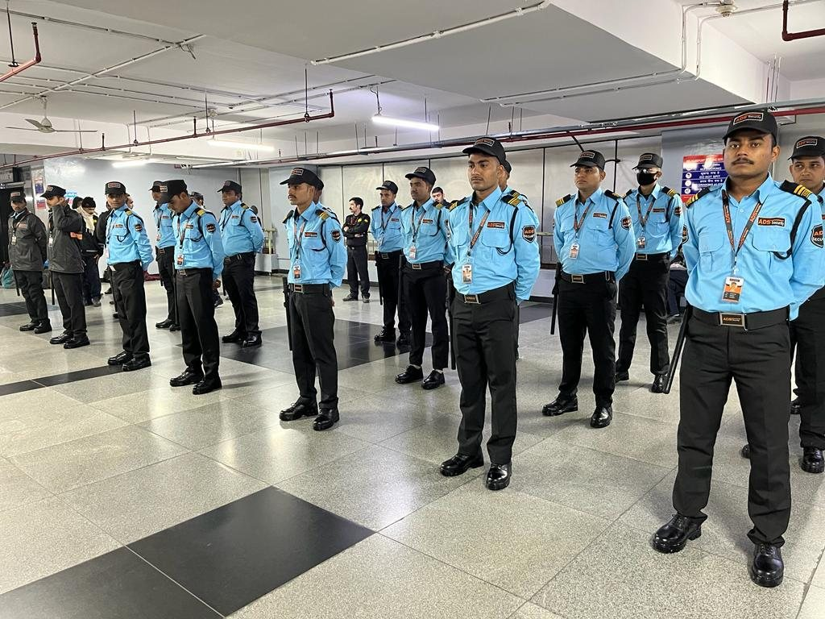




ADS MULTISERVICES
TRAINING
TRAINED. THEN DEPLOYED.
PHYSICAL TRAINING PROGRAMS
Discipline drills, safety protocols and on-ground readiness — every quarter.
DAILY BRIEFINGS & DRILLS
SOPs, client protocols, emergency response, conduct and accountability.
ADS TRAINING PLATFORM
Digital learning modules — every module tracked to completion for every employee.
DEPLOYED ONLY WHEN CERTIFIED
No professional reaches your site before clearing every module.
QUARTERLY DRILLS — AUTHORIZED TRAINING CENTERS
ADS MULTISERVICES · SECURITY SOLUTIONS
06

Slide 7



ADS MULTISERVICES
DAILY OPERATIONS
BEFORE EVERY SHIFT
EARLY REPORTING
BRIEFING
FITNESS CHECK
BREATH ANALYZER
PASS ✓
PASS ✓
PASS ✓
PASS ✓
CENTRAL COMMAND CENTER — REAL-TIME
SHIFT A & B — ALLOCATED
Automated rostering across every site
ATTENDANCE — SYNCED
Digital capture, no manual registers
FIELD OPERATIONS TRACKER
PATROL CHECKPOINTS — ON TRACK
Live patrol dots and checkpoint ticks, site by site
Every site monitored in real time — from one central command center.
ADS MULTISERVICES · SECURITY SOLUTIONS
07

Slide 8

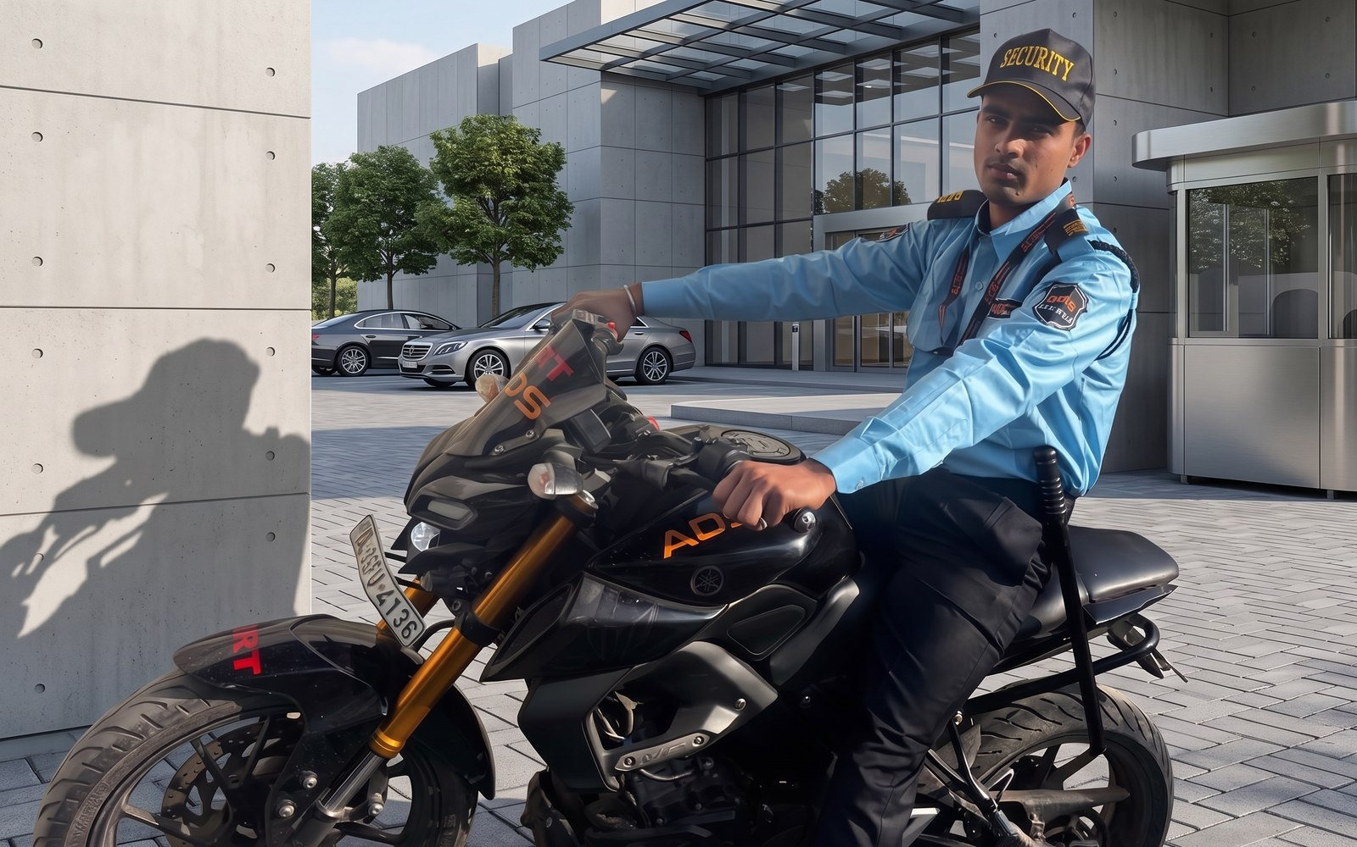
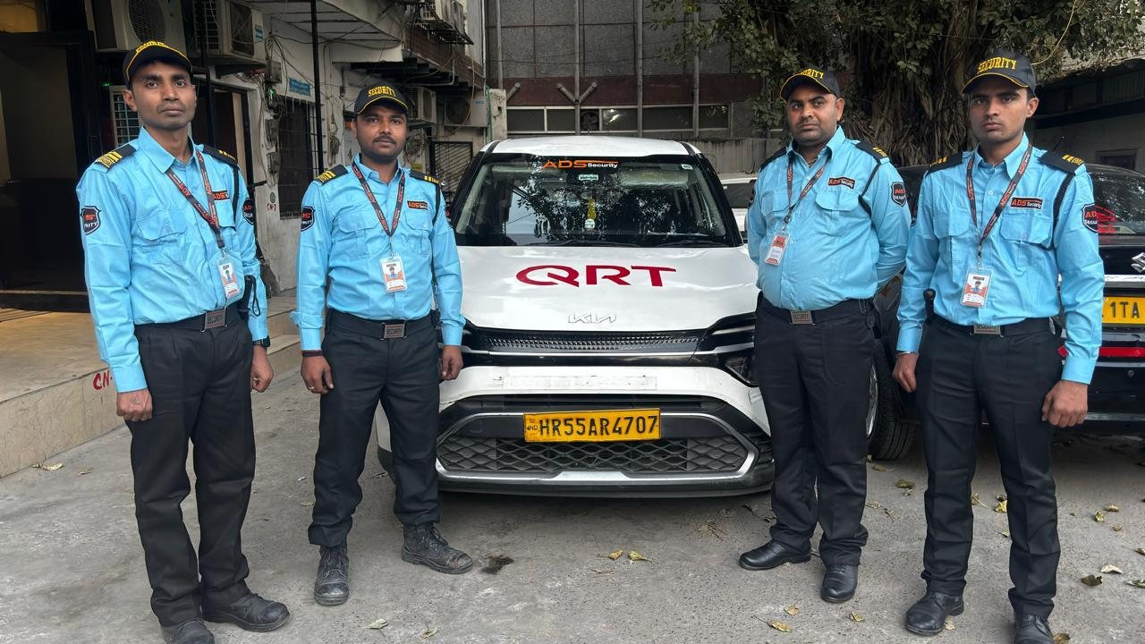
ADS MULTISERVICES
QUICK RESPONSE TEAM
EVERY SECOND COUNTS
One SOS reaches our command center instantly. Response rolls out in two tiers:
QRT BIKES — FIRST ON SCENE
QRT VANS — FULL TEAM RESPONSE
THROUGH TRAFFIC · IN MINUTES
EQUIPMENT · BACKUP · COORDINATION
COORDINATED WITH LOCAL POLICE · AMBULANCE · AGENCIES
INVESTIGATION REPORT SHARED WITH THE CLIENT — EVERY INCIDENT
ADS MULTISERVICES · SECURITY SOLUTIONS
08

Slide 9




ADS MULTISERVICES
TECHNOLOGY & BILLING
100% DIGITAL. FULLY TRANSPARENT.
→
→
ATTENDANCE
PAYROLL
INVOICE
Captured digitally, every day
Processed accurately, on time
Raised on schedule, fully itemized
PF ✓
ESI ✓
STATUTORY DOCS ✓
AUDIT-READY — every record, every month, every client.
ADS MULTISERVICES · SECURITY SOLUTIONS
09

Slide 10








ADS MULTISERVICES
OUR CLIENTS
TRUSTED BY LEADING ORGANIZATIONS
AIESL
INDIGO
UNITED AIRLINES
ANA
LENSKART
WEBHELP
NAVJEEVAN SOCIETY
ISO CERTIFIED
QUALITY STANDARDS
From banking to aviation and beyond — long-term partnerships built on process and trust.
ADS MULTISERVICES · SECURITY SOLUTIONS
10

Slide 11


ADS
MULTISERVICES
DRIVEN BY PROCESS. POWERED BY PEOPLE. TRUSTED BY CLIENTS.
Security is not a service — it is a responsibility.
ADSMULTISERVICES.IN
+91 93110 07739
ADS MULTISERVICES · SECURITY SOLUTIONS
11

